Slide 1
ME759 High Performance Computing for Applications in Engineering [Spring 2020]
Lecture 02
01/24/2019
Dan Negrut, 2020 ME759 UW-Madison

Slide 2
Quote of the day
“Sometimes I’ll start a sentence and I don’t even know where it’s going. I just hope I find it along the way.”
Michael Scott, Regional Manager, Dunder Mifflin Paper Company, Inc.

Slide 3
Second quote of the day
“Would I rather be feared or loved? Easy. Both. I want people to be afraid of how much they love me.”
Michael Scott, Regional Manager, Dunder Mifflin Paper Company, Inc.

Slide 4
Before we get started…
Last time: Overview of the course
ME759:
We’ll learn things about hardware
We’ll learn things about software environments that help us tap into that hardware
Use knowledge about software and hardware to run our codes faster
The first five-six assignments are hard, stay focused up front – things will get steady state in the second part of the semester
Today
A first step towards starting to consider the hardware that our code will run on
It’s not only the software that’s important. For speed, we must keep in mind the hardware that our software will run on
The bottom line: it takes to tango – the software half & the hardware half
Other tidbits:
Important reading assigned today, consult the syllabus:
Euler use policy
Slurm use and batch scripting for Slurm with sbatch
The “module” utility
Most importantly, read the material on C programming. And then read it again. Make sure you get “pointers”
First assignment went out yesterday, due on Th at 9 pm

Slide 5
The Hardware-Software Interplay

Slide 6
This segment’s purpose
Understand the basics of how the hardware works for the purpose of writing better software
Immediate focus: discuss how a sequence of instructions processes a bunch of data

Slide 7
From C Code to Machine Instructions (1/4)
Your program is the result of a compile step in which a source file is turned into an executable
Your lines of code, converted into machine instructions
What’s an “executable”?
Sequence of machine instructions that can be processed, one by one, by the processor
Execution concludes; i.e., your program done, when last instruction was taken care of
#include <stdio.h>
/* Simplest C Program */
int main(int argc, char **argv) {
printf("Hello World!\n");
return 0;
}
euler ~/ME759> gcc -o helloWorld helloWorld.cpp
euler ~/ME759> ls
helloWorld helloWorld.cxx
euler ~/ME759> srun -p slurm_shortgpu --pty -u ./helloWorld
srun: job 240350 queued and waiting for resources
srun: job 240350 has been allocated resources
Hello World!
euler ~/ME759>
Notes:
Typically, a line of code maps into more (some time many) instructions.
Once the instructions are encoded into machine code, they are indistinguishable from data (it’s only location in memory that can differentiate between data and instructions)

Slide 8
From C Code to Machine Instructions (2/4)
Punch line: There is a difference between a line a code and a machine instruction
Example:
Line of C code:
a[4] = delta + a[3]; //line of C code
MIPS assembly code generated by the compiler (three instructions):
lw $t0, 12($s2) # reg $t0 gets value stored 12 bytes from address in $s2
add $t0, $s4, $t0 # reg $t0 gets the sum of values stored in reg $s4 and reg $t0
sw $t0, 16($s2) # store what’s in $t0 at mem location 16 bytes from address in $s2
Set of three corresponding MIPS instructions produced by the compiler:
10001110010010000000000000001100
00000010100010000100000000100000
10101110010010000000000000010000
Notes:
Typically, a line of code maps into more (some time many) instructions.
Once the instructions are encoded into machine code, they are indistinguishable from data (it’s only location in memory that can differentiate between data and instructions)

Slide 9
From C Code to Machine Instructions (3/4)
C code – what you write to implement an algorithm
Assembly code – intermediate step for compiler, humans can still read it
Spend 5 mins here: https://godbolt.org
Machine code/Instructions – what the assembly code gets translated into by the compiler and what the control unit (CU) digests
Machine code: what you see in an editor (notepad, vim , etc.) if you open an executable file (basically gibberish)
There is a one-to-one correspondence between a line of assembly code and an instruction
(most of the time; particularly true for certain processors)
Notes:
But code → assembly is not unique (compilers are free to optimize)

Slide 10
From C Code to Machine Instructions (4/4)
Observations:
The compiler typically goes from C code directly to machine instructions
Back in the day, people programmed computers via assembly code
Today writing assembly code done only for critical parts of a program by people who want to highly optimize the execution and choose to overrule the compiler
Notes:
Embedded systems

Slide 11
More on the “assembly instructions” side of things
We’ll not cover assembly in ME759
If you really are into computing though, you should learn how to read “assembly code”
Why?
In critical cases you might want to check that the compiler does what you think it should do
Examples: you optimize the code with –O3 and want to confirm that
A for-loop got unrolled to reduce the number of jump conditions and improve changes for pipelining
A function got inlined to avoid a pair of jumps that ruin pipelining

Slide 12
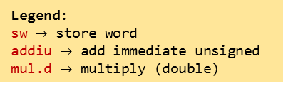
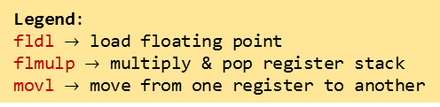
Example: the same C code leads to different assembly code (and different set of machine instructions, not shown here)
int main(){
const double fctr = 3.14/180.0;
double a = 60.0;
double b = 120.0;
double c;
c = fctr*(a + b);
return 0;
}
C code
main:
.frame $fp,48,$31 # vars= 32, regs= 1/0, args= 0, gp= 8
.mask 0x40000000,-4
.fmask 0x00000000,0
.set noreorder
.set nomacro
addiu $sp,$sp,-48
sw $fp,44($sp)
move $fp,$sp
lui $2,%hi($LC0)
lwc1
…
mul.d $f0,$f2,$f0
swc1 $f0,32($fp)
swc1 $f1,36($fp)
move $2,$0
move $sp,$fp
lw $fp,44($sp)
addiu $sp,$sp,48
j $31
…
$LC0:
.word 3649767765
.word 1066523892
.align 3
$LC1:
.word 0
.word 1078853632
.align 3
$LC2:
.word 0
.word 1079902208
.ident "GCC: (Gentoo 4.6.3 p1.6, pie-0.5.2) 4.6.3"
x86 ISA
call ___main
fldl LC0
fstpl -40(%ebp)
fldl LC1
fstpl -32(%ebp)
fldl LC2
fstpl -24(%ebp)
fldl -32(%ebp)
faddl -24(%ebp)
fldl LC0
fmulp %st, %st(1)
fstpl -16(%ebp)
movl $0, %eax
addl $36, %esp
popl %ecx
popl %ebp
leal -4(%ecx), %esp
ret
LC0:
.long 387883269
.long 1066524452
.align 8
LC1:
.long 0
.long 1078853632
.align 8
LC2:
.long 0
.long 1079902208
Legend:
fldl $→$ load floating point
flmulp $→$ multiply & pop register stack
movl $→$ move from one register to another
MIPS ISA
Legend:
sw $→$ store word
addiu $→$ add immediate unsigned
mul.d $→$ multiply (double)
Notes:
x86: special case of CISC (Intel, AMD)
MIPS (Microprocessor without Interlocked Pipeline Stages): special case of RISC
fldl → load floating point
flmulp → multiply and pop the register stack
movl → move from one register to another (long operand)
sw → store word
addiu → add immediate unsigned
mul.d → multiply (double)

Slide 13
fldl, sw, addiu, lw, mul.d, … - What is this???
There is a limited number of stipulations that the CU understands and thus can take care of
This set of commands/stipulations makes up the Instruction Set Architecture (ISA)

Slide 14
Instruction Set Architecture (ISA)
The same line of C code can lead to a different set of instructions on two different computers
This is so because two CPUs might implement two different ISAs
ISA: defines a “vocabulary” subsequently used by the compiler to specify the actions of a processor
Notes:
An Instruction Set Architecture is like a set tools that you have in your backpack.
If you have a task that you need to do, you’ll have to use a collection of tools to see it through.
A different ISA might have more complex tools and as such with only a small number of tools you get the job done.

Slide 15
ISA: Two more important schools of thought
One school of thought: promotes the RISC paradigm
Second school of thought: promotes the CISC paradigm
RISC or CISC? Which one is better?
Topic of perpetual debate, like Bud or Miller Draft

Slide 16
The RISC ISA flavor
RISC Architecture – Reduced Instruction Set Computing Architecture
An instruction coded into a set of 32 bits
Recently moved to 64 bits
Thus, a program is just a bunch of fixed length instructions (either 32, or more recently 64)
Promoted by ARM Holdings, company that started as ARM (Advanced RISC Machines)
Used in embedded systems, smart phones – Intel, NVIDIA, Samsung, Qualcomm, TI
Somewhere between 8 and 10 billion chips based on ARM manufactured annually
IBM also adopted a variant of this (one Euler node uses ARM)
Notes:
CISC: Much more effort required to decode; but more expressive (SIMD extensions)
variable length instruction: 32-bit, followed by 256-bit, followed by 128-bit, etc.
RISC: all instructions have fixed length; easier (and cheaper) to decode.

Slide 17
The CISC ISA flavor
CISC Architecture – Complex Instruction Set Computing Architecture
Instructions have various lengths
Intel’s X86 is the most common example
Promoted by Intel and subsequently embraced & augmented by AMD
Used in laptops, desktops, workstations, servers
Notes:
CISC: Much more effort required to decode; but more expressive (SIMD extensions)
variable length instruction: 32-bit, followed by 256-bit, followed by 128-bit, etc.
RISC: all instructions have fixed length; easier (and cheaper) to decode.

Slide 18
The main ISA flavors: RISC vs. CISC
RISC simpler to comprehend, provision for, and work with
CISC is more expressive
Decoding CISC instructions is not trivial and eats up power
A CISC instruction is usually broken down into several micro-operations (uops)
CISC Architectures: flexibility at the price of complexity and power
A more intricate ISA, leads to complex microarchitecture (circuitry, that is) & eats up more power
Notes:
CISC offers a much larger set of instructions, more complex (at the end of the day they are also broken down in micro-instructions which start resembling the RISC instructions)
Main reason for using RISC on mobile devices: much lower power requirements
Main reason for using CISC: more flexibility and performance (e.g. SIMD, AVX)

Slide 19
Computing requires instructions and data
In terms of storage and movement, there is no distinction between data and instructions
Instructions are fetched & decoded & executed (more on this later)
Data is used to produce results according to rules specified by the instructions
A piece of data: stored in memory as a string of 0 and 1 bits (8 bits, or 16, or 64, etc. – can even be user defined)
An instruction: stored in memory as a string of 0 and 1 bits (often 32 or 64 bits – kind of fixed, you don’t have a say)
NOTE: the “data & instructions share same storage and pathways” paradigm formalized by von Neumann in late 1940s
The “von Neumann model” (also known as the Princeton model)
Memory Data
Instructions
Data
[Cache] Memory
Processor
(Chip)
instructions flow
Control Unit (CU)
Arithmetic Logic Unit (ALU)
data flow
internal consumption (uops)
internal consumption data
Notes:
Also known as Princeton model
Harvard model (architecture): separate storage and pathways for data and instructions
This model relies on the FDX cycle
The process of processing instructions (FDX) intermediated by the processor’s CU

Slide 20
The FDX Cycle [New Topic: pertains to “what happens with an instruction?” question]
FDX stands for Fetch-Decode-Execute
FDX is what keeps the CU and ALU busy
FDX is done for instruction after instruction until program completes
Fetch: an instruction is fetched from memory
Might look something like this (on 32 bits, MIPS, lw $t0, 12($s2)):
10001110010010000000000000001100
Decode: this string of 1s and 0s are decoded by the CU
Example: here’s an “I” (eye) type instruction, made up of four fields
Execute: once all data (operands) available, instruction is executed
The execution can take several cycles of the CPU [more later]
Notes:
Whatever ISA is used, at execution time these instructions need to be:
fetched (brought over from memory)
decoded (interpreted, to some extent “undoing” what the compiler did which was an encoding into ISA)
executed (dispatched to the ALUs)
All these are performed by the CU

Slide 21
Decoding: Instructions Types
The main types of instructions in MIPS ISA:
Type I (immediate)
Type R (register)
Type J (jump)
Two more flavors for floating point operands
FI – like I but for floating point numbers
FR – like R but for floating point numbers
Notes:
Just a taste of the various MIPS instructions.
I (immediate) type: specify two registers and an immediate value; allows instruction and data to be loaded in a single cycle
R (register) type: specify three registers (two for operands, one for result)
J (jump) type: specify a jump target

Slide 22
Type I (MIPS ISA)
op (6 bits)
rs (5 bits)
rt (5 bits)
constant or address (16 bits)
The first six bits encode the basic operation to be completed (opcode)
The next group of five bits: in which register the first operand is stored
The subsequent group of five bits: the target register, rt
The 16 bit “immediate” value, usually used as the offset value in various instructions
“Immediate” means that there is no need to read other registers or jump through other hoops. Immediately good to go
Example:
32 bits
100011
00110
00101
0000 0000 0000 1000
lw $5, 8($6)
op
rs
rt
rd
Notes:
For I instructions, the operation is completely defined by the opcode
addi $t,$s,C $t = $s + C (signed) 001000 sssss ttttt CCCC CCCC CCCC CCCC

Slide 23
Type R (MIPS ISA)
Type R has the same first three fields op, rs, rt like I-type
Packs three additional fields:
Five bit rd field (register destination)
Five bit shamt field (shift amount)
Six bit funct field, which is a function code that further qualifies the opcode
Example:
op (6 bits)
rs (5 bits)
rt (5 bits)
rd (5 bits)
shamt (5 bits)
funct (6 bits)
32 bits
000000
00011
00010
00100
00000
100000
op
rs
rt
rd
shamt
funct
add $4, $3, $2
Notes:
DAN: see http://courses.cs.washington.edu/courses/cse378/09au/lectures/cse378au09-04.pdf for a nice discussion of I and R type instructions

Slide 24
Type J (MIPS ISA)
op (6 bits)
address (26 bits)
Execution
instructions
32 bits
Type J has an op field and an address field
Jump instruction has a word address, not an offset
A 26-bit address field allows for jumps to any address between 0 and 2²⁶-1
Longer jumps use the “jump register” instruction: jr $ra # jump to address in register $ra
Procedure called
first time here
Procedure called
second time here
[http://www.divms.uiowa.edu/~ghosh/1-24-06.pdf]$→$
Notes:
For J instructions, the operation is completely defined by the opcode.
Just two J-type instructions (j and jal). These set the PC register!
Can jump to an address less than 256 MB
jr is R-type

Slide 25
Picking up the instruction type…
How does the CU figure out what instruction type it deals with?
Is it I, R, or J?
This information is baked into the operation code (opcode)

Slide 26
[New Topic] Instruction Set Architecture vs. Chip Microarchitecture
ISA – defines a vocabulary
Specifies what a processor should be able to do
Load, store, jump on less than, etc.
Microarchitecture – how the silicon is organized to implement the vocabulary embodied by the ISA
Reflect on this: Intel and AMD both use the x86 ISA. However, they work off different microarchitectures
Notes:
ISA: the “contract”, the “promise” of what can be done. Similar to a standard
Microarchitecture: implementation in silicon (transistors) of that contract. Similar to an implementation of the standard
Analogy: the functions of a TV set. What’s done to implement those functions changes from company to company (Samsung vs. Sony)
2 chips can support the exact same ISA but with completely different microarchitecture. One can have better hardware for a particular instruction (specialization for supercomputing, graphics, servers, etc.)

Slide 27
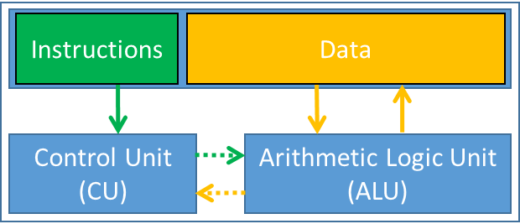
Schematic, middle-of-the-road CPU Microarchitecture
Instruction Control
Fetch
Control
Address
Instruction
Cache
Retirement
Unit
Register
File
Instruction
Decode
Instructions
Operations
Register Updates
Prediction OK?
Execution
Functional
Units
Branch
Arith.
Arith.
Arith.
Load
Store
Operation Results
Addr.
Addr.
Data
Data
Data
Cache
[Bryant and O‘Hallaron: CMU] →
Notes:
5.4.7.4. Retirement Unit
The retirement unit writes the results of speculatively executed microoperations into the user-visible registers and removes the microoperations from the reorder buffer. Like the reservation station, the retirement unit continuously checks the status of microoperations in the reorder buffer, looking for ones that have been executed and no longer have any dependencies with other microoperations in the instruction pool. It then retires completed microoperations in their original program order.
The retirement unit can retire three microoperations per clock cycle (/<-- this may be outdated/). In retiring a microoperation, it writes the results to the processor’s register file and/or memory. After the results have been written, the microoperation is removed from the re-order buffer.
http://users.utcluj.ro/~baruch/book_ssce/SSCE-Intel-Pipeline.pdf

Slide 28
The CPU’s Control Unit (CU)
The CU controls the “datapath” (i.e., the functional units + registers + buses)
CU has several duties, such as
Bringing in the next instruction from memory
Decoding the instruction (possibly breaking it up into uops)
Engaging in actions to enable “instruction level parallelism” (ILP, more later)
CU manages/coordinates based on information encoded in the instruction at hand
Notes:
The CU controls the DATAPATH (the functional units + registers + buses)

Slide 29
The CPU’s Arithmetic Logic Unit (ALU)
Made up of a bunch of so called “execution units” or “functional units”
In charge of executing arithmetic and load/store operations
Examples:
Arithmetic multiply/add unit (for integers)
Arithmetic multiply/add unit (for floats)
Special function unit
Called upon to computes sin, cos, exp, log, etc.
Etc.

Slide 30
FDX Cycle – The Execution Part: It All Boils Down to Transistors…
How does the magic happen?
Transistors are organized into complex logical units capable of performing simple operations
More transistors increase opportunities for building/implementing in silicon additional functional units that can operate at the same time towards a shared goal
Notes:
A transistor (when used in a CPU) is essentially a switch, like a light switch except that you don't have to turn it on or off manually. Rather, it is controlled by an electrical current. The most important thing to understand is that modern computers are two-state devices: the only thing that really matters is whether a wire has a current or not.

Slide 31
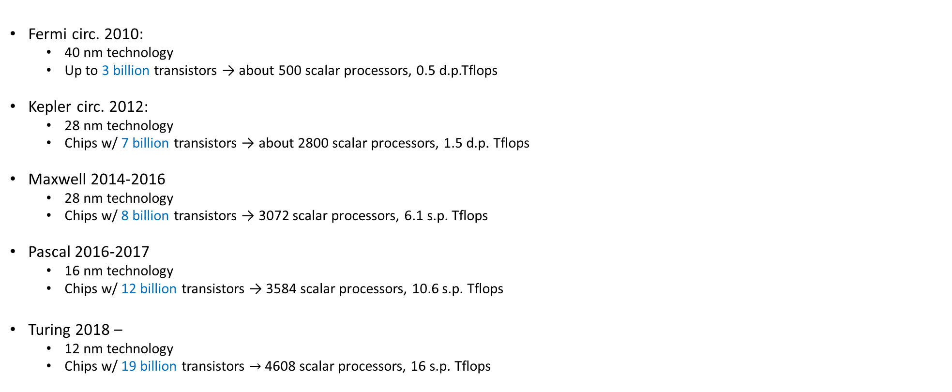
Number of Transistors, on GPUs [NVIDIA architectures]
Fermi circ. 2010:
40 nm technology
Up to 3 billion transistors → about 500 scalar processors, 0.5 d.p.Tflops
Kepler circ. 2012:
28 nm technology
Chips w/ 7 billion transistors → about 2800 scalar processors, 1.5 d.p. Tflops
Maxwell 2014-2016
28 nm technology
Chips w/ 8 billion transistors → 3072 scalar processors, 6.1 s.p. Tflops
Pascal 2016-2017
16 nm technology
Chips w/ 12 billion transistors → 3584 scalar processors, 10.6 s.p. Tflops
Turing 2018 –
12 nm technology
Chips w/ 19 billion transistors $→$ 4608 scalar processors, 16 s.p. Tflops
Notes:
GPUs are the largest chips (in terms of number of transistors)
Overview of Maxwell is here: http://www.tomshardware.com/reviews/nvidia-geforce-gtx-titan-x-gm200-maxwell,4091.html
Pascal:
FinFET technology
Integrates NVLink technology
Intel Haswell: 1.4 billion transistors
Intel Broadwell: 7 billion transistors

Slide 32
Transistors: why we love them & want as many as possible
Focus first on how transistors are used to perform tasks (tied to CU and ALU use)
Later talk about how transistors are used to store data and instructions
Memory Data
Instructions
Data
Memory
Processor
(Chip)
instructions flow
Control Unit (CU)
Arithmetic Logic Unit (ALU)
data flow
internal consumption (uops?)
internal consumption data

Slide 33
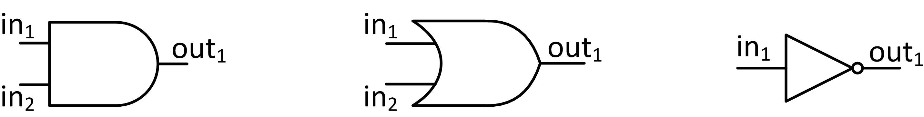
Transistors at work: AND, OR, NOT
The NOT logical operation is implemented using one transistor
AND and OR logical ops require two transistors
Truth tables for AND, OR, and NOT
AND
OR
NOT
AND | in₂=0 | in₂=1
in₁=0 | 0 | 0
in₁=1 | 0 | 1
OR | in₂=0 | in₂=1
in₁=0 | 0 | 1
in₁=1 | 1 | 1
NOT
in₁=0 | 1
in₁=1 | 0
Notes:
Functional completeness: NAND + NOR
Also: AND + NOT

Slide 34
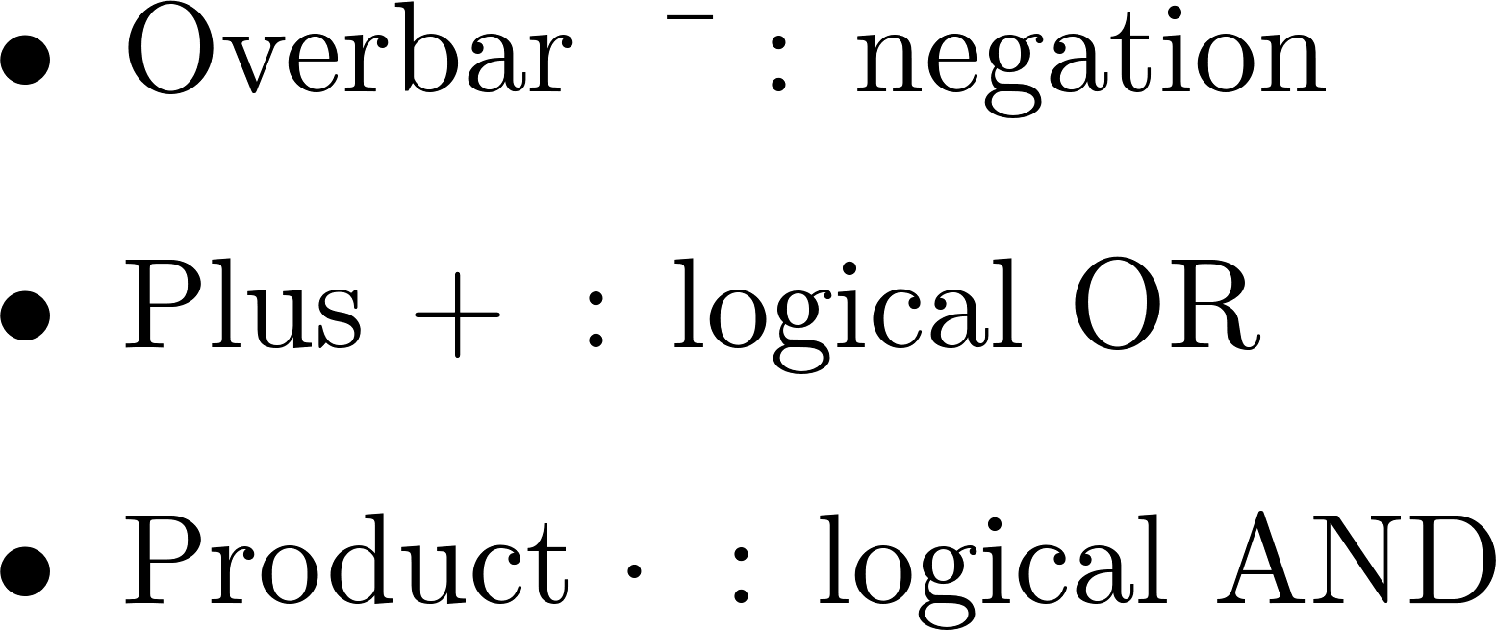
Example (1/2) [cooked up, but makes a point]
Design a digital logic block that receives three inputs via three bus wires and produces one signal that is 0 (low voltage) as soon as any of the three input signals is low voltage.
In other words, it should return 1 if and only if all three inputs are 1
A bit-wise “&”
Truth Table
Logic Equation:
in₁ | in₂ | in₃ | Out
0 | 0 | 0 | 0
0 | 0 | 1 | 0
0 | 1 | 0 | 0
0 | 1 | 1 | 0
1 | 0 | 0 | 0
1 | 0 | 1 | 0
1 | 1 | 0 | 0
1 | 1 | 1 | 1
Legend:
NOTE: There are several Logic Equations that implement the same Truth Table. There are tradeoffs that one can make (power/space/speed)
Notes:
Complex logic can be built with these building blocks (gates)
Example:
start with desired truth table
deduce logic equation
map to gates

Slide 35
Example (2/2) [cooked up, but makes a point]
Easy to figure out the transistor setup once Logic Equation is available
Truth Table
Logic Equation:
in₁ | in₂ | in₃ | Out
0 | 0 | 0 | 0
0 | 0 | 1 | 0
0 | 1 | 0 | 0
0 | 1 | 1 | 0
1 | 0 | 0 | 0
1 | 0 | 1 | 0
1 | 1 | 0 | 0
1 | 1 | 1 | 1
Solution: digital logic block is a combination of AND, OR, and NOT gates
The NOT is represented as a circle O applied to signals moving down the bus

Slide 36
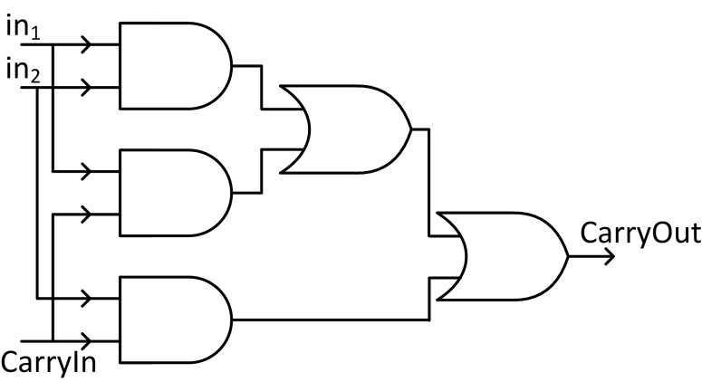
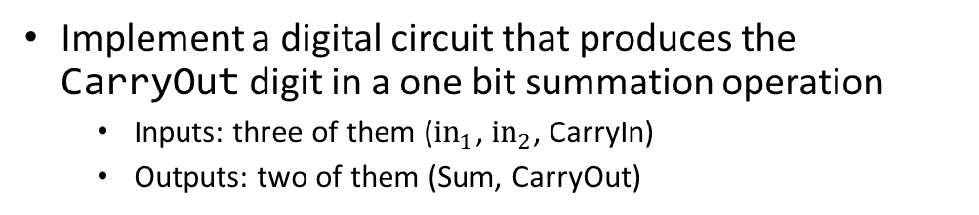
Example: One Bit Adder (visualize calculating 567+789)
Implement a digital circuit that produces the CarryOut digit in a one bit summation operation
Inputs: three of them (${in}_{1}$, $in_{2}$, CarryIn)
Outputs: two of them (Sum, CarryOut)
Truth Table
Logic Equation (for CarryOut):
Inputs |  |  | Outputs |  | Comments
in₁ | in₂ | CarryIn | Sum | CarryOut | Sum is in base 2
0 | 0 | 0 | 0 | 0
0 | 0 | 1 | 1 | 0 | 0+0 is 0; the CarryIn kicks in, makes the sum 1
0 | 1 | 0 | 1 | 0
0 | 1 | 1 | 0 | 1 | 0+1 is 1, but CarryIn is 1; sum ends up being 0, CarryOut is 1.
1 | 0 | 0 | 1 | 0
1 | 0 | 1 | 0 | 1 | 1+0 is 1, but CarryIn is 1; sum ends up being 0, CarryOut is 1.
1 | 1 | 0 | 0 | 1 | 1+1 is 0, carry 1.
1 | 1 | 1 | 1 | 1 | 1+1 is 0 and you CarryOut 1. Yet the CarryIn is 1, so the 0 in the sum becomes 1.
Notes:
Addition (in base 10 or base 2) requires two outputs: the sum and the carry_out
567+789

Slide 37
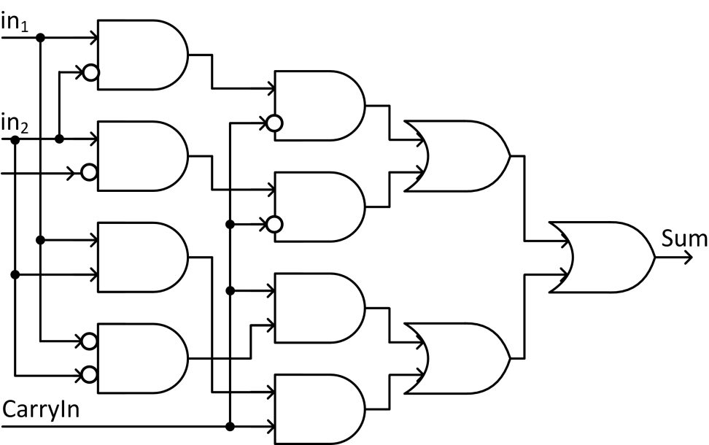
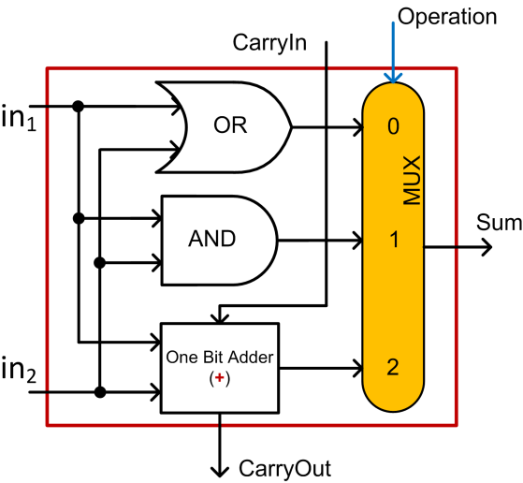
Integrated Circuits-A One Bit Combo: OR, AND, 1 Bit Adder
1 Bit Adder, the Sum part
A One Bit Combo: OR, AND, 1 Bit Sum
Controlled by the input “Operation”
result
Notes:
Main idea: combine simpler blocks to get a more complex block
Throw in a multiplexor (a “selector”) and you can build a more complex “LEGO brick”, a COMBO

Slide 38
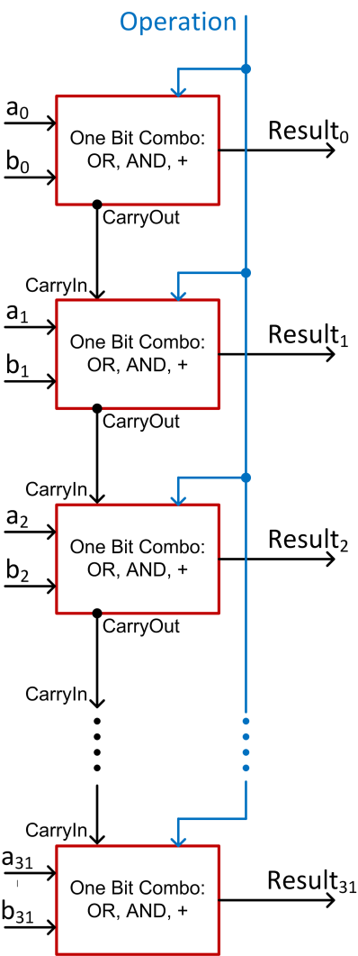
Integrated Circuits: Ripple Design of 32-Bit Combo
Combine 32 of the 1 bit combos in an array of logic elements
Get one 32 bit unit that can do OR, AND, +
This “academic example” design requires about 1152 transistors
Notes:
A 32-bit ripple-carry adder will require about 1152 transistors.
This is an academic example. Actual micro-architecture ALUs implement a different, more sophisticated logic.

Slide 39
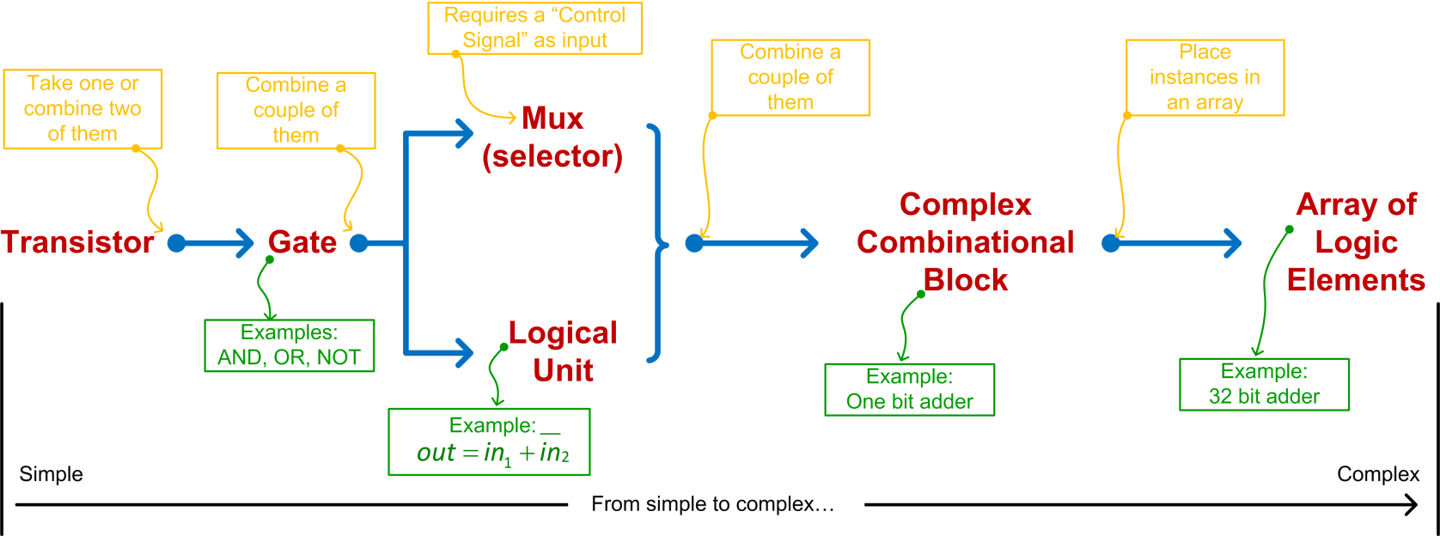
Integrated Circuits: From Transistors to Chip Microarchitecture
Notes:
Trend: simple to complex

Slide 40
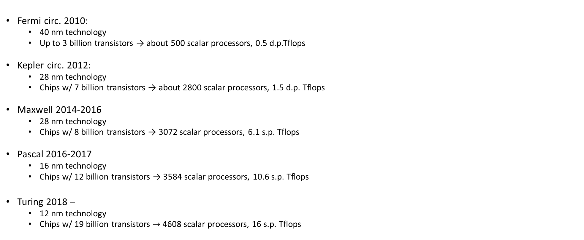
Example: Number of Transistors, on GPUs [NVIDIA architectures]
Fermi circ. 2010:
40 nm technology
Up to 3 billion transistors → about 500 scalar processors, 0.5 d.p.Tflops
Kepler circ. 2012:
28 nm technology
Chips w/ 7 billion transistors → about 2800 scalar processors, 1.5 d.p. Tflops
Maxwell 2014-2016
28 nm technology
Chips w/ 8 billion transistors → 3072 scalar processors, 6.1 s.p. Tflops
Pascal 2016-2017
16 nm technology
Chips w/ 12 billion transistors → 3584 scalar processors, 10.6 s.p. Tflops
Turing 2018 –
12 nm technology
Chips w/ 19 billion transistors $→$ 4608 scalar processors, 16 s.p. Tflops
Notes:
GPUs are the largest chips (in terms of number of transistors)
Overview of Maxwell is here: http://www.tomshardware.com/reviews/nvidia-geforce-gtx-titan-x-gm200-maxwell,4091.html
Pascal:
FinFET technology
Integrates NVLink technology
Intel Haswell: 1.4 billion transistors
Intel Broadwell: 7 billion transistors

Slide 41
[FDEX Cycle: Execution Closing Remarks] It All Boils Down to Transistors…
For 50 years, every 18 months, number of transistors per unit area doubled (Moore’s Law)
2014-2015 technology: feature length was 14 nm (Intel)
2018: 10 nm -12 nm
Current technology (2019-2020): 7 nm (top of the line - AMD)
Looking ahead (2021): 5 nm
No clear path forward after 2021
Maybe Carbon Nanotubes?
Notes:
We will come back to Moore’s law and mention that it starts breaking: the pace slows down

Slide 42
Registers

Slide 43
Registers, backdrop (1/2)
Instruction cycle: fetch-decode-execute
CU – responsible for controlling the process that will deliver the request baked into the instruction
ALU – does the busy work to fulfill the request put forward by the instruction
The instruction that is being executed should be stored somewhere
Fulfilling the requests baked into an instruction usually involves input values and generates output values
This data needs to be stored somewhere
Notes:
“Stored somewhere” → in registers

Slide 44
Registers, backdrop (2/2)
Registers, quick facts:
A register is an entity whose role is that of storing information
A register is the storage type with shortest latency – it’s closest to the CU & ALU
The number and size of registers used are specific to an ISA
Prime example of how ISA decides on something and the microarchitecture has to do what it takes to implement this design decision
Back in the day, MIPS ISA: there were 32 registers of 32 bits (no more, no less)
Notes:
Typically, an n-bit register might require 4n … 8n transistors
Note: MIPS64 also uses 32 registers
Don’t expect to see too many registers: precious commodities which are located on prime real-estate

Slide 45
Register Types (1/4)
Discussion herein covers only several register types typically encountered in a CPU (abbreviation in parenthesis)
List not comprehensive, showing only the more important ones
Instruction Register (IR) – holds the instruction that is executed
Sometimes known as “current instruction register” CIR
Program Counter (PC) – holds address of the instruction executed next
NOTE: unlike IR, PC contains *address* of the instruction, not actual instruction
Notes:
An utility that monitors the program counter can tell you what the hot spots of your executable are
PC is used by profilers to see which instructions are hot-spots

Slide 46
Register Types (2/4)
Memory Data Register (MDR) – holds data read in from memory or, alternatively, produced by the ALU and waiting to be stored in memory
Memory Address Register (MAR) – holds address of RAM memory location where input/output data is supposed to be read in/written out
NOTE: unlike MDR, MAR contains *address* of a mem location, not actual data
Return Address (RA) – the address where upon finishing a sequence of instructions, the execution should jump and commence with the execution of subsequent instruction
Notes:
Other typical registers:
AC (accumulator): typically resides in the ALU

Slide 47
Register Types (3/4)
Registers on previous two slides are a staple in most ISA
There are several other registers common to many chip designs
These are encountered in different numbers (also depending on ISA)
Since they come in larger numbers they don’t have an acronym
Registers for Subroutine Arguments (4) – a0 through a3
Registers for Temporary Variables (10) – t0 through t9
Registers for Saved Temporary Variables (8) – s0 through s7
Saved between function calls
Notes:
Side-note: here’s where the “common wisdom” of having fewer subroutine arguments comes from: there are only 4 registers to store them. When more, additional manipulations.

Slide 48
Register Types (4/4)
Several other registers are involved in handling function calls
Summarized below, their meaning only apparent in conjunction with the organization of the virtual memory
Stack Pointer (sp) – a register that holds an address that points to the top of the stack
Global Pointer (gp) – a register that holds an address that points to the middle of a block of memory in the static data segment
Frame Pointer (fp) - a register that holds an address that points to the beginning of the procedure frame (for instance, the previous sp before this function changed its value)
Notes:
Virtual memory – at the end of this segment

Slide 49
Register, Departing Thoughts
Registers: a very precious resource
If they are so good, why can’t we have more?
Increasing their number is not straightforward
Need to change the design of the chip (the microarchitecture) & not enough space (maybe go 3D?)
Need to change the very nature of an instruction (and as such ISA gets touched in the process)
Examples:
In 32-bit MIPS ISA, there are 32 registers
GP100 GPU (Pascal): 56 SMs, each with 64 SPs. Total register file: 14336K (~3.5 million registers)
Seems impressive but it’s not: 56 SMs * 2048 threads/SM * 32 registers/thread (guesstimate) = 3.6 million registers needed
Notes:
We will see why so many registers on a GPU (don’t read too much into it right now)
Pascal: up to 2048 resident threads/SM → they all need registers
There’s a maximum of 255 registers/thread limit

Slide 50
Pipelining
“Nothing is particularly hard if you divide it into small jobs.”
Henry Ford

Slide 51

Comic of the day: Too many cooks spoil the broth.
[https://t.co/kYI3Mz1iKF]$→$

Slide 52

Workers on the first moving assembly line put together magnetos and flywheels for 1913 Ford autos. Highland Park, Michigan
http://www.gpschools.org/ci/depts/eng/k5/third/fordpic.htm [public domain]

Slide 53
Pipelining, or the Assembly Line Concept
Henry Ford: capitalized on, and improved the assembly line idea on an industrial scale and in the process shaped the automotive industry (Ford Model T)
Vehicle assembly line: a good example of a pipelined process
The output of one stage (station) becomes the input for the downstream stage
Once assembly line primed, a vehicle gets finished/manufactured during each cycle
“cycle” is the time it takes from the moment a station gets its input to the moment its output leaves the station

Slide 54


https://www.rediff.com/business/report/hyundai-uses-580-robots-in-chennai-plant-maruti-5000/20180530.htm
Historical change of the manufacturing line. Manual assembly line (left); Hyundai assembly line in Chennai, India (right)
Steve Jurvetson and Mike Bird [Creative Commons Attribution-Share Alike 4.0 International]$→$

Slide 55
Leaving Car Analogy Behind…
FDX cycle: Fetch, Decode, Execute - carried out for each machine instruction
Sometimes called FDXW (W: “Write”)
A closer look at what gets fetched (instructions and data) and then what happens upon execution leads to a generic five-stage process associated with an instruction
“generic” above means that, in a first order approximation, these five stages can represent any instruction, although some instructions might not have all five stages:
Stage 1: Fetch an instruction
Stage 2: Decode the instruction
Stage 3: Data access
Stage 4: Execute the operation (e.g., might be a request to calculate an address)
Stage 5: Write-back into register file
[Patterson, 4th edition]→
Notes:
Modern CPU pipelines are 14-19 deep

Slide 56
Rules of thumb: costs to perform an operation > 1 cycle
Four cycles for SW
Five cycles for LW
Four cycles for add
Etc.

Slide 57
Pipelining, the basics
Assume a five-stage pipeline
Pipelining, cornerstone idea: the following tasks can be worked upon simultaneously when processing five instructions:
Instruction 1 is in the 5th stage of the FDX cycle
Instruction 2 is in the 4th stage of the FDX cycle
Instruction 3 is in the 3rd stage of the FDX cycle
Instruction 4 is in the 2nd stage of the FDX cycle
Instruction 5 is in the 1st stage of the FDX cycle
Notes:
Balance issue:
For the simple 5-stage RISC pipeline discussed here, this is mostly true:
register read/write ~100 ns
fetch/ALU/data read ~200 ns
Modern processor: deep pipelines, because instructions are further broken down to be comparable in time

Slide 58
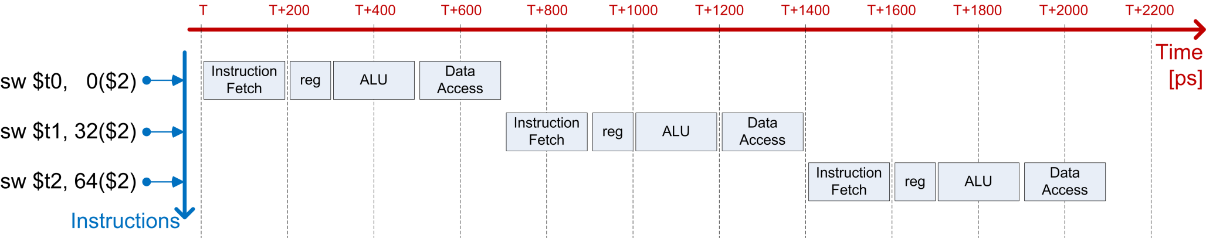
Example: Streaming for execution 3 SW instructions
sw $t0, 0($s2)
sw $t1, 32($s2)
sw $t2, 64($s2)
Case 1: No pipelining – 2100 picoseconds [ps]
Notes:
sw: in MIPS means ‘store word’
ALU used to add offset
sw: no data access needed (missing stage 3)

Slide 59
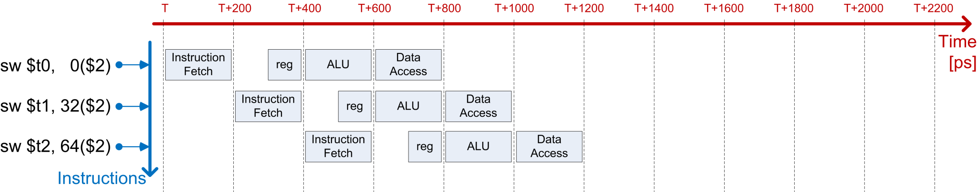
Example: Streaming for execution 3 SW instructions
sw $t0, 0($s2)
sw $t1, 32($s2)
sw $t2, 64($s2)
Case 2: With pipelining – 1200 picoseconds [ps] (5 GHz clock cycle)
Notes:
Pipelining in use since the 1990s

Slide 60
Pipelining: on its “balanced” attribute
An ideal situation is when each of pipeline stage takes the same amount of time for completion
The pipeline is then balanced
If pipeline not balanced, there will be stations that wait for the laggard station at every single cycle
Common sense: If there is a station that takes a significantly longer time since it does significantly more than other stations, it should be broken into two and the length of the pipeline increases by one station
Leads to deeper pipelines
Typical pipeline depth today: 12-15 stages
Notes:
Balance issue:
For the simple 5-stage RISC pipeline discussed here, this is mostly true:
register read/write ~100 ns
fetch/ALU/data read ~200 ns
Modern processor: deep pipelines, because instructions are further broken down to be comparable in time

